Slide 1

MS Solution Service Portal – Mini Project
A MERN Stack Website for Small Service Businesses
Presented by: Suhani S Shaikh

Slide 2
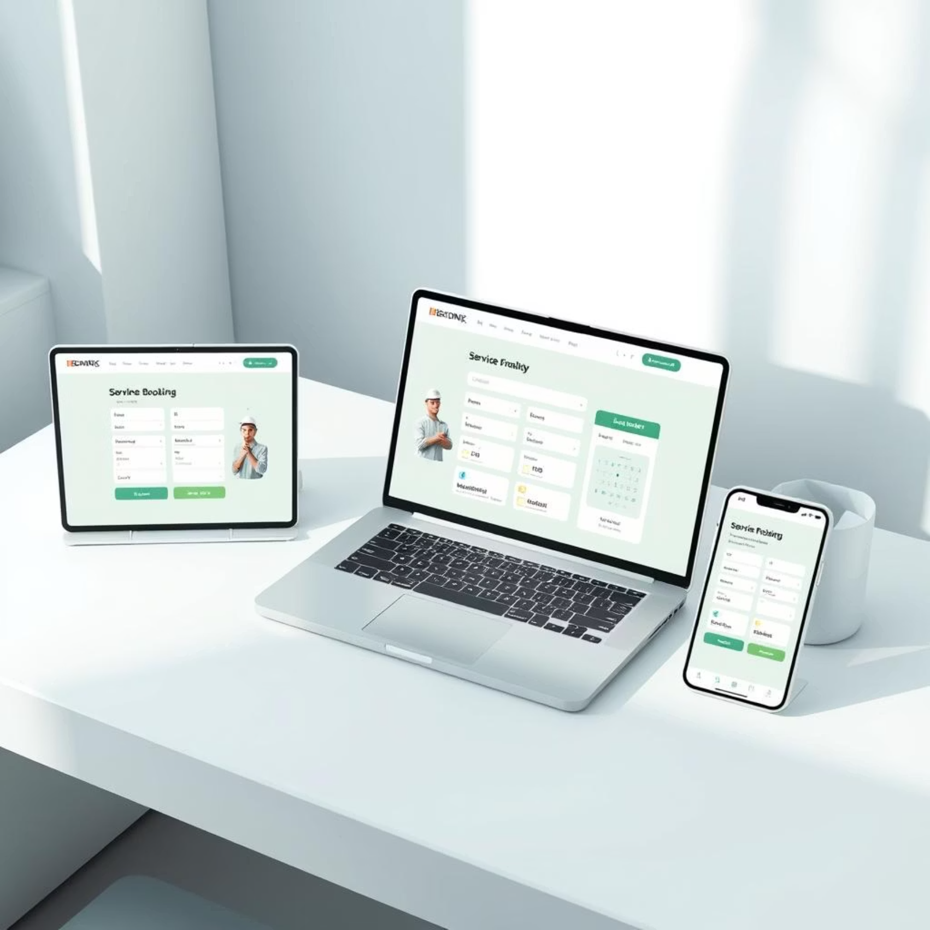
Introduction
In this project, I am developing a responsive web application for M.S Solution, a small business, to enhance their online presence and make booking services easier for customers. The application allows users to view the home, about, and services pages, and book services directly through a booking form by providing their details and email. Once a booking is submitted, it is received in the admin panel, where the admin can accept or manage the booking, triggering an email notification to the user. This project is built using the MERN stack (MongoDB, Express, React, Node.js) with a focus on creating a simple, user-friendly, and fully responsive application to support the business’s operations online.

Slide 3
Problem Statement
To automate service bookings for M.S Solution by allowing users to book services, while admins manage requests through the admin panel and send real-time email notifications.

Slide 4




Core Modules and Key Features
The service portal is structured into distinct modules, each designed to enhance user experience and operational efficiency.
Front-End Pages
Booking & Tracking
Home, About, Services pages
Online service scheduling
Booking page, booking form
Real-time status updates for customers(via email)
Admin Panel
Contact & Feedback
Secure login for administrators
Integrated contact forms
Manage requests: accept, reject, complete
Platform for customer feedback
Update service details dynamically

Slide 5
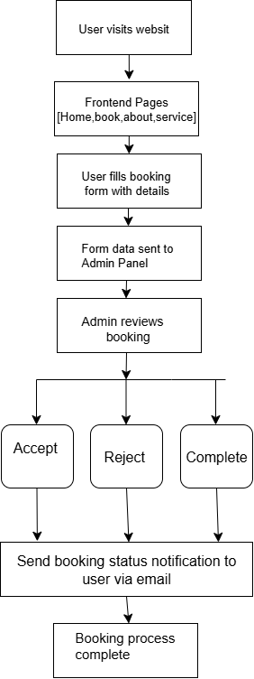
Flowchart

Slide 6



Technologies :
A modern tech stack ensures performance, scalability, and a rich user experience.
Frontend
Backend & Database
Authentication & Deployment
React.js: Dynamic user interfaces
Node.js + Express.js: RESTful API development
JWT: Secure admin authentication
React Router DOM: Seamless navigation
MongoDB Atlas: Scalable NoSQL cloud database
Nodemailer: Automated email notifications
Tailwind CSS/Bootstrap: Responsive design and styling
Vercel: Frontend deployment
Render: Backend deployment

